Slide 1
Project Presentation #6
Team E: Jiayu Yao, Shang Liu, Yuqiao Han

Slide 2
Goals
Features
Analyze factors that highly affect on Youtube video popularity.
Find out the top ten rules and attributes that contribute to high views on YouTube.
Input features:
Channel Frequency, Posting Time(hour), Video Category, Tag Words Length, Title Length, Number of Stop Words in Title, Number of Stop Words in Tag, Brackets in Title, Numbers in Title, Special Characters in Title, Contains Facebook Links in Descriptions, Contains Instagram Links in Descriptions, Video Duration Time (days)
Output features:
Average number of daily views

Slide 3
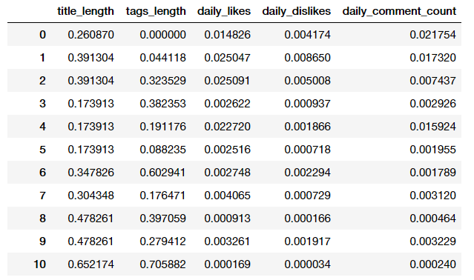
Feature Normalization

Slide 4
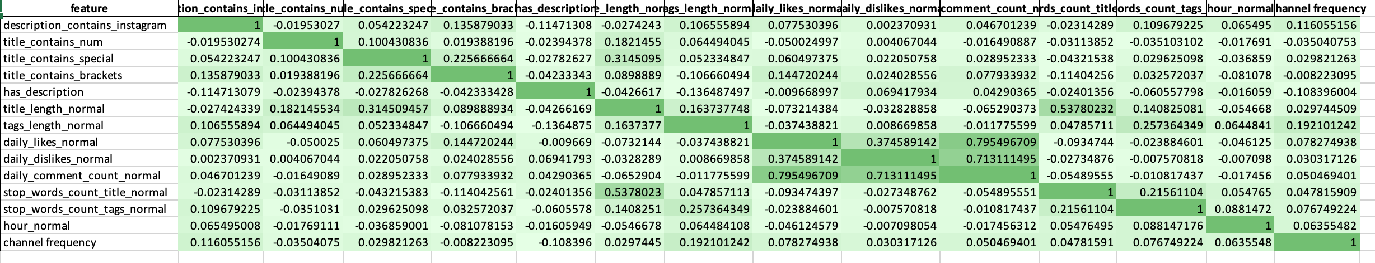
Feature Correlation - Pearson Correlation

Slide 5
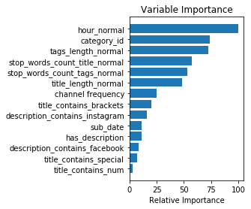
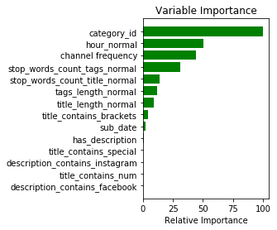
Feature Importance
Gradient Boosting Regressor
Random Forest Regressor

Slide 6
Top 8 Most Importance Features
Video posting hour (the hour on posting day)
Video Category
Tag word length
Number of stop words in title
Number of stop words in tags
Channel Posting Frequency
Title Length
Title Contain Brackets

Slide 7
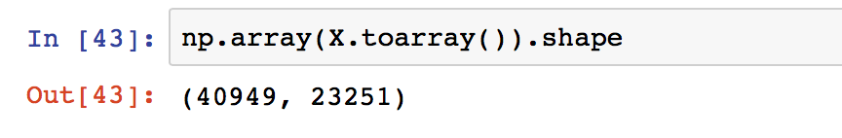
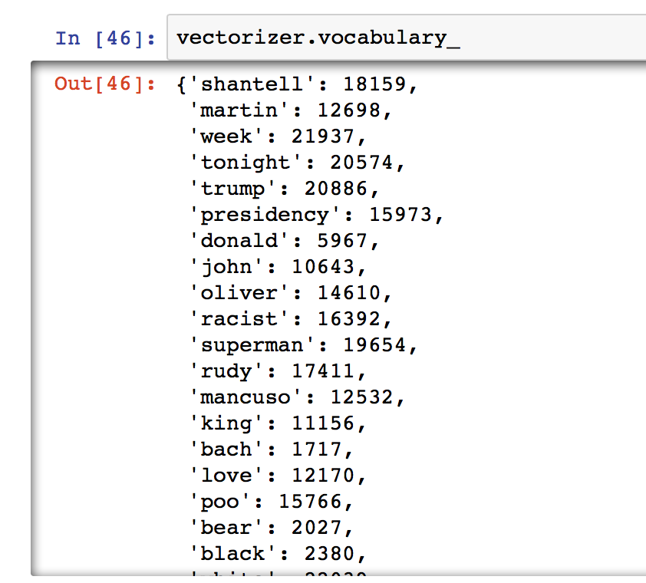
Bag of Words

Slide 8
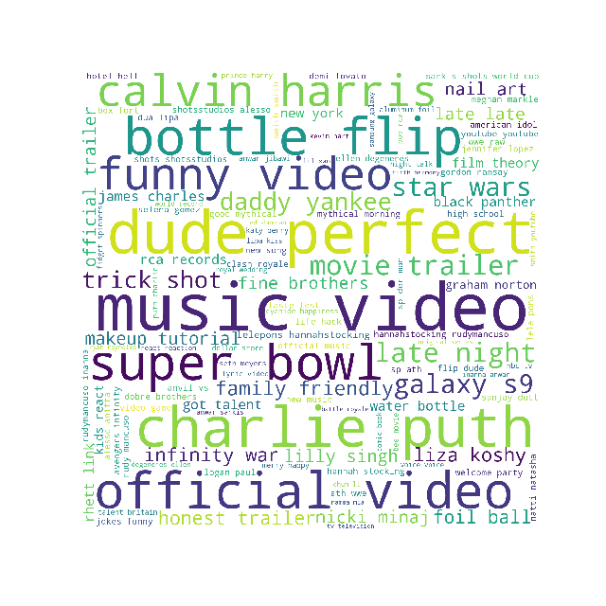
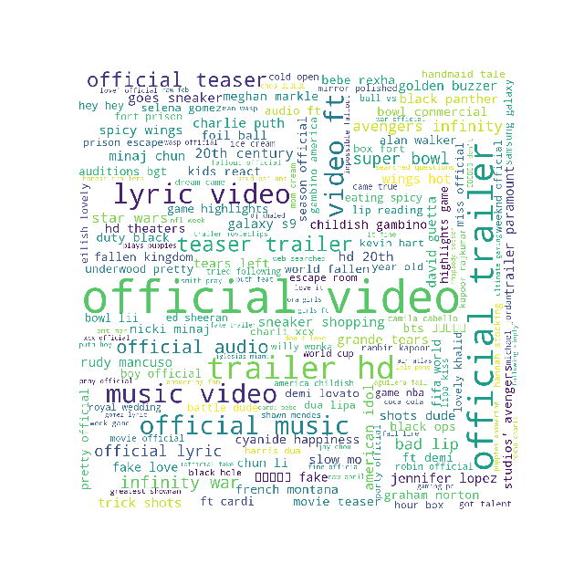
Top Tag Words
Top Title Words

